Slide 1
LANCOM Product Overview
… connecting your business (16 pt)
23. January 2014

Slide 2
LANCOM Product Overview
… connecting your business (16 pt)
23. January 2014

Slide 3
Headline (24 pt, bold) Subheadline (20 pt, normal)

Slide 4
Headline (24 pt, bold) Subheadline (20 pt, normal)

Slide 5
Headline (24 pt, bold) Subheadline (20 pt, normal)

Slide 6
LANCOM Systems GmbH
Wireless LAN Indoor
23. January 2014

Slide 7
LANCOM Systems GmbH
Network Connectivity
23. January 2014

Slide 8
LANCOM Systems GmbH
Network Connectivity
23. January 2014

Slide 9
LANCOM Systems GmbH
Wireless LAN Outdoor
23. January 2014

Slide 10
LANCOM Systems GmbH
Product Management and Development
23. January 2014

Slide 11
LANCOM Systems GmbH
Security
23. January 2014

Slide 12
LANCOM Systems GmbH
LANvantage Partner Program
23. January 2014

Slide 13
LANCOM Systems GmbH
Service & Support
23. January 2014

Slide 14
LANCOM Systems GmbH
Training Center
23. January 2014

Slide 15
LANCOM Systems GmbH
Retail Solutions
23. January 2014

Slide 16
LANCOM Systems GmbH
Education Solutions
23. January 2014

Slide 17
LANCOM Systems GmbH
Education Solutions
23. January 2014

Slide 18
LANCOM Systems GmbH
Public Solutions
23. January 2014

Slide 19
LANCOM Systems GmbH
Healthcare Solutions
23. January 2014

Slide 20
LANCOM Systems GmbH
Logistics Solutions
23. January 2014

Slide 21
LANCOM Systems GmbH
Hospitality Solutions
23. January 2014

Slide 22
LANCOM Systems GmbH
Hospitality Solutions
23. January 2014

Slide 23
LANCOM Systems GmbH
Conference
23. January 2014

Slide 24
LANCOM Systems GmbH
Management Solutions
23. January 2014

Slide 25
LANCOM Systems GmbH
Development
23. January 2014

Slide 26
LANCOM Colouring
Additional colors for graphics and diagramms etc.
LANCOM blue
Red 59, Green 128, Blue 194
Network Connectivity
Red 254, Green 154, Blue 39
Secundary colors
Red 89, Green 153, Blue 206
Wireless LAN
Red 101, Green 192, Blue 254
Red 137, Green 179, Blue 218
Service & Support
Red 220, Green 0, Blue 46
Red 177, Green 204, Blue 231
LANvantage Partner Program
Red 73, Green 180, Blue 0
Red 216, Green 230, Blue 243
Management & Rollout
Red 255, Green 208, Blue 0
Font color
Red 112, Green 113, Blue 115

Slide 27
LANCOM Table Sample
1. Headline | 2. Headline | 3. Headline

Slide 28
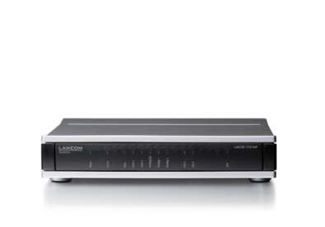

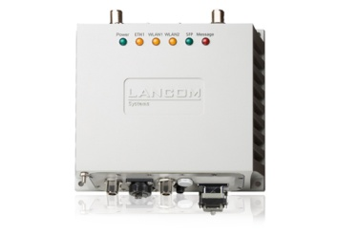
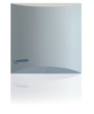




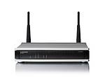
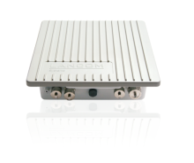
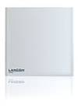

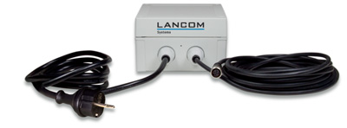
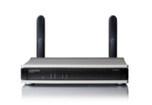



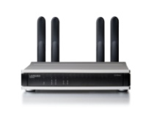
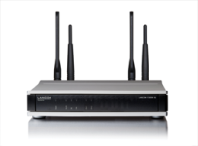




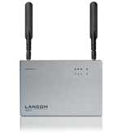
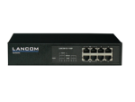
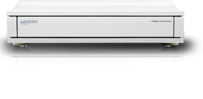




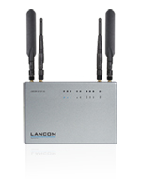
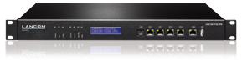

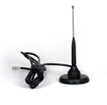
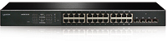
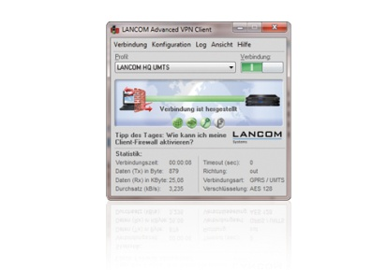
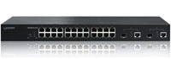
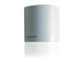
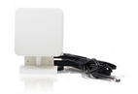
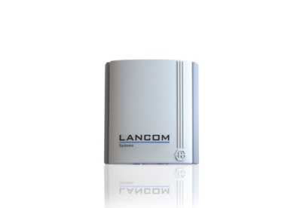
LANCOM Icons Products
Router
Product name
Product name
AirLancer
Extender O-30
Product name
Cable
WLAN AP
UMTS Router
Product name
Product name
Product name
Product name
WLAN AP
WLAN AP
WLAN AP
Product name
Product name
AirLancer
Extender O-360-3G
AirLancer
Extender O-9a
VPN Gateway
AirLancer
Extender SA-5L
Outdoor
WLAN AP
Product name
Product name
AirLancer
Extender O-360ag
WLAN Controller
Product name
Produktname
Product name
AirLancer
Extender O-D9a
AirLancer
ExtenderSA-LAN
Ethernet Switch
AirLancer
Extender I-360-4G
WLAN AP
Product name
Product name
AirLancer
Extender O-18a
Product name
AirLancer
Extender I-360-3G
Product name
AirLancer
Extender O-70
AriLancer
Extender O-360-4G
Product name

Slide 29











































LANCOM Icons
Laptop with WLAN
Laptop
PC
PC with WLAN
Monitor
Smartphone
Tablet PC
PDA
Mobile phone
SIM card
Analog telephone
ISDN telephone
Dect telephone
VoIP telephone
PBX
Hotspot
WLAN
Point-to-point
Server/database
Firewall
Internet
Fax
Printer
NTBA
Layer 2 Switch
Router
Content inspection
Gateway access server
Encryption
Document
VPN tunnel
Content Filter
Spam
No Spam
Filter
EC Card
Cash terminal
Register
ERP system
Digital signage
Video control
Hand-held scanner

Slide 30













LANCOM Icons
Industry
Building
Home Office
Desktop
Videoconference
Person
Group
Motel
Cafe
Coffee
Car
Lifter
Lorry

Slide 31





































LANCOM Buttons
Network Connectivity
Specials
Wireless LAN
Service Options
Software Options

Slide 32





























LANCOM Logos
Others

Slide 33




CC Logos

Slide 34











Awards

Slide 35
Thank you for your attention! Further information…
See for more informationen for products, solutions and services at www.lancom.eu
LANCOM Systems GmbH Adenauerstraße 20/B2 52146 Wuerselen Germany
info@lancom.eu

Slide 36
Vielen Dank für Ihre Aufmerksamkeit! Weitere Informationen…
Weitere Informationen zu unseren Produkten, Lösungen und Services unter: www.lancom.de
LANCOM Systems GmbH Adenauerstraße 20/B2 52146 Würselen
info@lancom.de

